Slide 1
Programming with Java
Anan Yaagoub - PhD
Northwestern University

Slide 2
Week 2 - Agenda
… Code Syntax and Reading
OOP
  Public, private, abstract, static, extend, implement, interface, …
  setter, getter, inherit, instantiate, generic, …
  Encapsulation, Polymorphism, …
  Constructor, Override, Overload, …
  Generics, inner class, super, …
ADT: Priority Queues
  Array
  Linked List
  Binary Heap

Slide 3
Part I

Slide 4
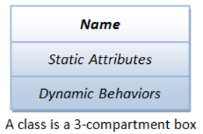
OOP – What is an Object?
Break a large task into smaller tasks (objects)
The basic unit of OOP is a class, which encapsulates
  Data -- properties and (object state)
  dynamic operations.
  Since classes are well-encapsulated, it is easier to reuse these classes.
  In other words, OOP combines the data structures and algorithms of a software entity inside the same box.
OOP languages permit higher level of abstraction for solving real-life problems. Not data structure only!

Slide 5
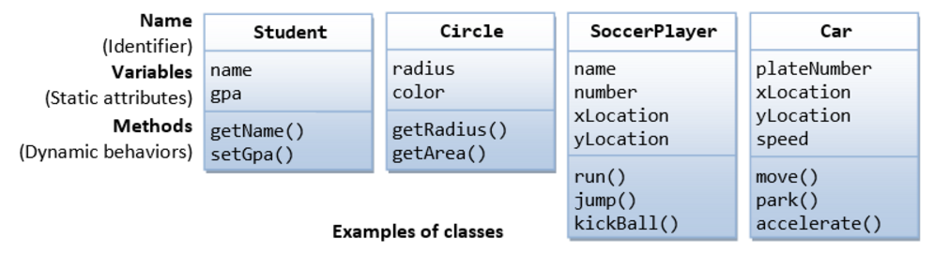
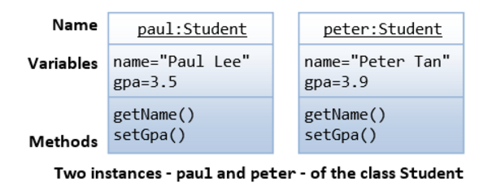
OOP - Examples

Slide 6

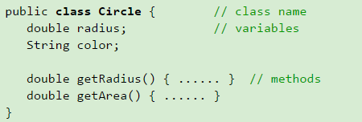
Class Definition in Java
A class is a programmer-defined, abstract, self-contained, reusable software entity that mimics a real-world thing.
A class is a 3-compartment box containing the name, variables and the methods.
A class encapsulates the data structures (in variables) and algorithms (in methods). The values of the variables constitute its state. The methods constitute its behaviors.
An instance is an instantiation (or realization) of a particular item of a class.

Slide 7
Classes …
Inside an Object:
  Methods can call any method within class
  Follow variable scope rules
Creating Instances of a Class
  Circle c1;
  Circle c1 = new Circle();
Dot (.) Operator
  suppose there is a class called AClass
  with a member variable called aVariable
  and a member method called aMethod().
  An instance called anInstance is constructed for AClass.
  You use anInstance.aVariable and anInstance.aMethod().

Slide 8
Source File Rules
There can be only one public class per source file.
A source file can have multiple non public classes.
The public class name should be the name of the source file as well which should be appended by .java at the end.
If the class is defined inside a package, then the package statement should be the first statement in the source file.
If import statements are present then they must be written between the package statement and the class declaration.
If there are no package statements then the import statement should be the first line in the source file.
Classes have several access levels and there are different types of classes; abstract classes, final classes, etc.

Slide 9
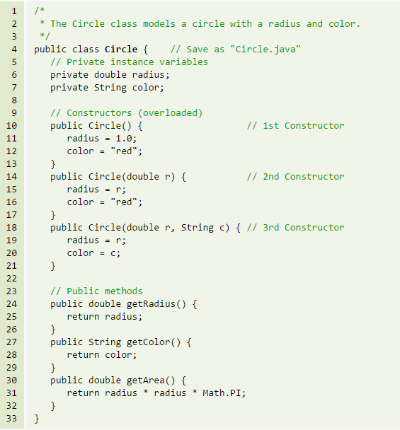
Circle Class
Documentation
Constructor
Member Methods
Member Variables
Overloading
? Destructor

Slide 10
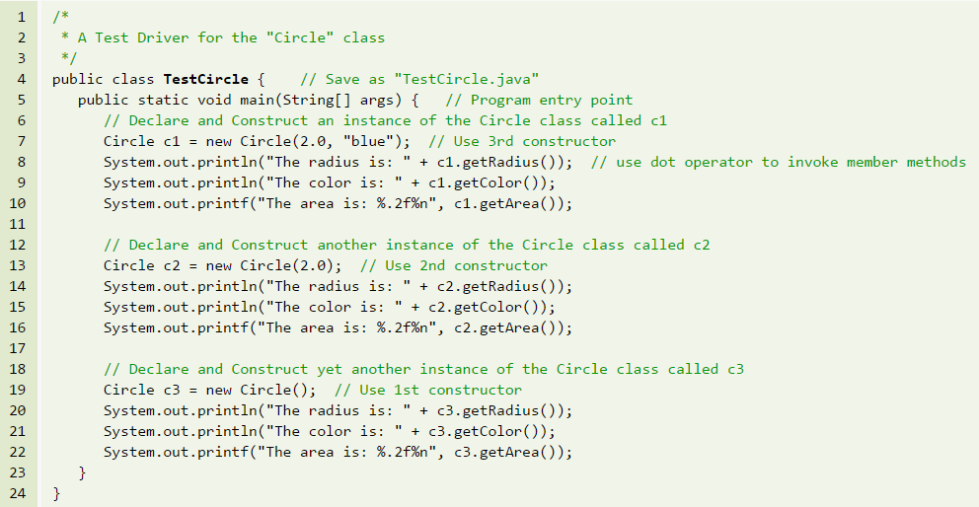
Class Test
Tester Class

Slide 11

Public/private - Access Control Modifiers
Variables
Methods
An access control modifier control the visibility of:
  Class
  member variable
  member method within a class.
public: The class/variable/method is accessible and available to all the other objects in the system.
private: The class/variable/method is accessible and available within this class only.

Slide 12
Information Hiding and Encapsulation
Member variables of a class are typically hidden from the outside word (i.e., the other classes), with private access control modifier.
Access to the member variables are provided via public assessor methods, e.g., getRadius() and getColor().
Rule of Thumb: Do not make any variable public, unless you have a good reason.
The public Getters and Setters for private Variables

Slide 13
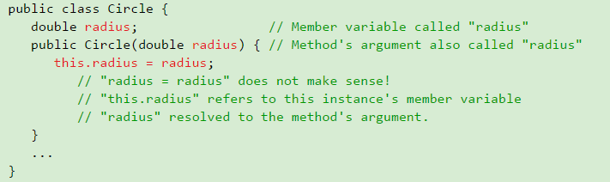

this – toString()
Keyword "this"
Method toString()

Slide 14
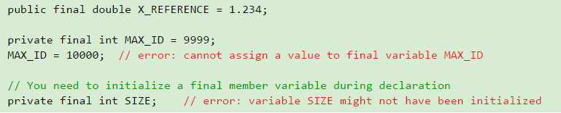
final - keyword
A final primitive variable cannot be re-assigned a new value.
A final instance cannot be re-assigned a new object.
A final class cannot be sub-classed (or extended).
A final method cannot be overridden.

Slide 15
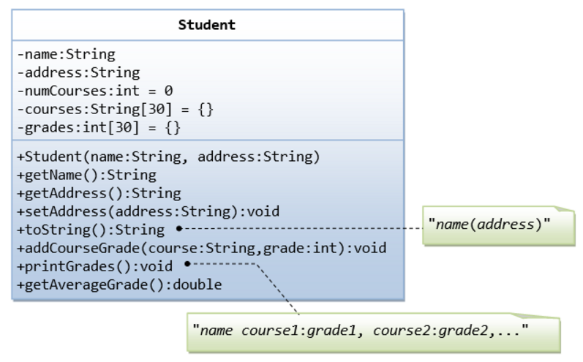
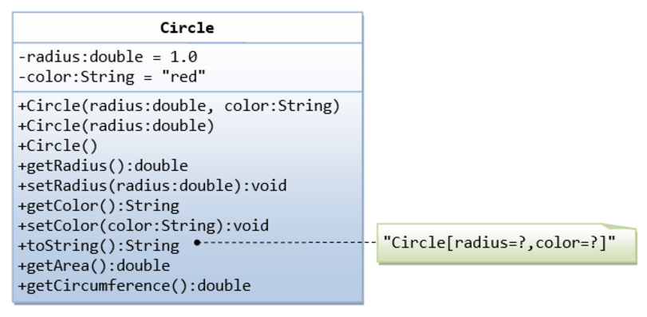
Programming Example - Circle
Example 1 – Circle Class
Example 2 – Student Class

Slide 16
OOP - Features
Reusability: there are two ways to reuse existing classes
  Composition: you define a new class, which is composed of existing classes
  Inheritance: derive a new class based on an existing class, with modifications or extensions.
Polymorphism
Abstract Classes and Methods
Interfaces

Slide 17
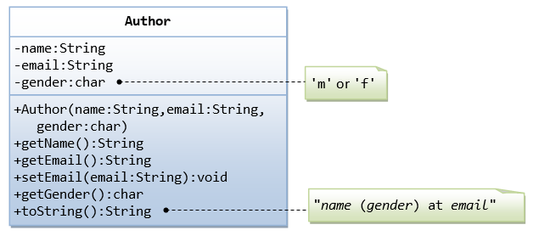
Composition
// Test constructor and toString()
Author aYaag = new Author(“Anan Y", “a@nowhere.com", 'm');
System.out.println(aYaag); // toString()
// Test Setters and Getters
aYaag.setEmail("teck@somewhere.com");
System.out.println(aYaag); // toString()
System.out.println("name is: " + aYaag.getName());

Slide 18
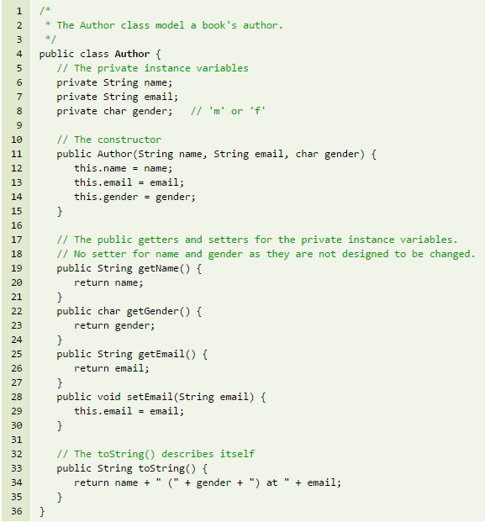
Composition …

Slide 19
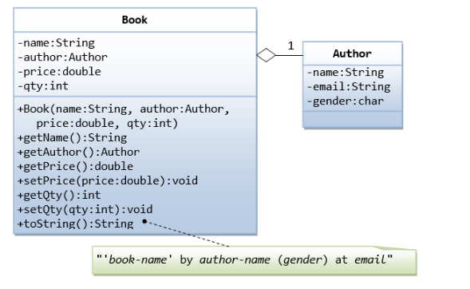
Composition …

Slide 20
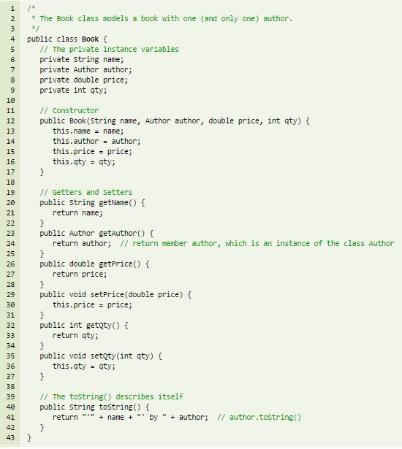
Composition …

Slide 21
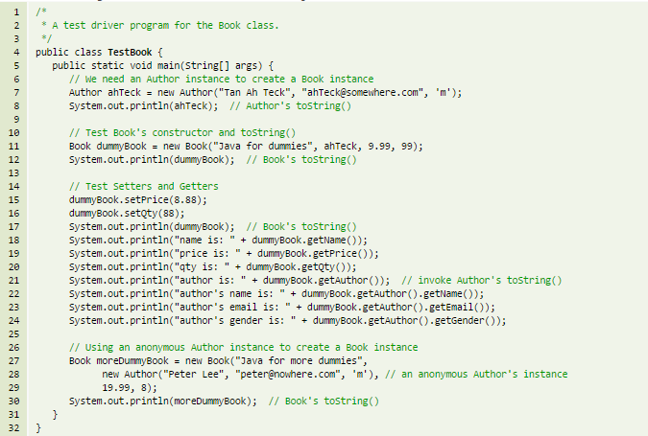
Composition …

Slide 22
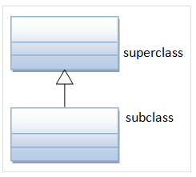
Inheritance
organize classes in hierarchy to avoid duplication and reduce redundancy.
The classes in the lower hierarchy inherit all the variables (static attributes) and methods (dynamic behaviors) from the higher hierarchies.
A class in the lower hierarchy is called a subclass (or derived, child, extended class).
A class in the upper hierarchy is called a superclass (or base, parent class).

Slide 23
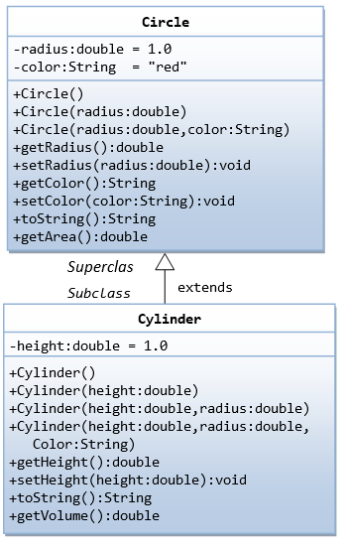

Inheritance - Example

Slide 24
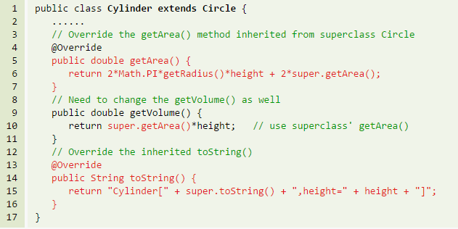
Inheritance - Overriding & Hiding
A subclass can:
  use the inherited methods and variables as they are.
  override an inherited method by providing its own version.
  hide an inherited variable by defining a variable of the same name.
  The "@Override" is annotation - asks compiler to check whether there is such a method in the superclass to be overridden -misspell

Slide 25
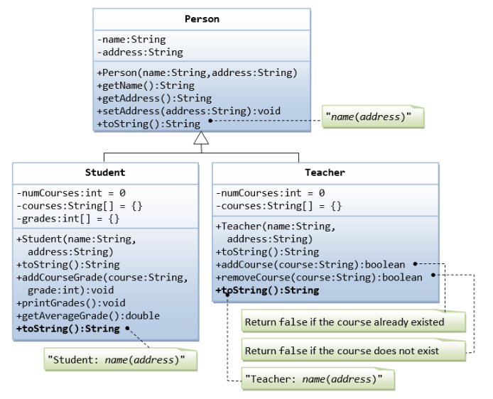
Inheritance - Example

Slide 26
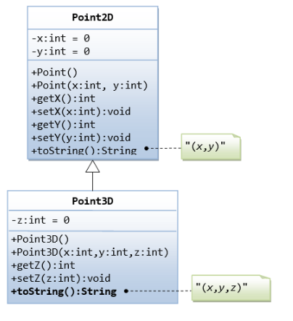
Inheritance - Example

Slide 27

Inheritance - rules
Keyword "super“ - refers to the superclass
  access superclass' methods and variables within the subclass' definition.
  super() and super(argumentList) can be used invoke the superclass’ constructor.
  If the subclass overrides a method inherited from its superclass, says getArea(), you can use super.getArea() to invoke the superclass' version.
  if your subclass hides one of the superclass' variable, you can use super.variableName to refer to the hidden variable.
Default no-arg Constructor
Single Inheritance
  Java does not support multiple inheritance (C++ does).
Common Root Class - java.lang.Object
  All Java classes are derived from a common root class called java.lang.Object.
Composition vs. Inheritance
  "A line is composed of 2 points" vs. "A line is a point extended by another point"

Slide 28
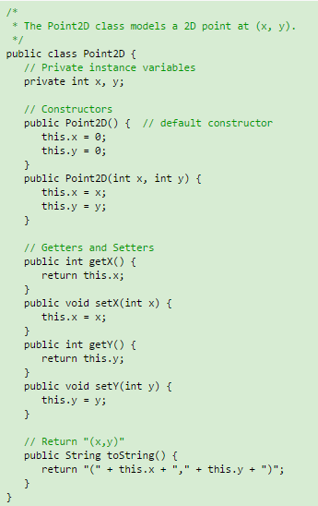
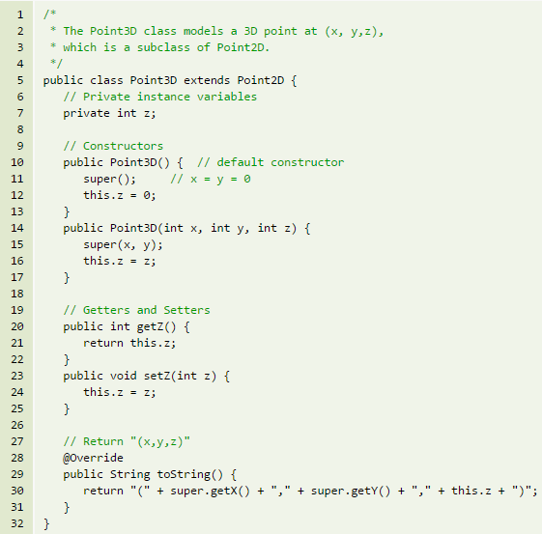
Inheritance - Example

Slide 29
Polymorphism
The word "polymorphism" means "many forms". It comes from Greek word "poly" (means many) and "morphos" (means form).
For examples, in chemistry, carbon exhibits polymorphism because it can be found in more than one form: graphite and diamond. But, each of the form has it own distinct properties (and price).
Substitutability
  A subclass possesses all the attributes and operations of its superclass.
  This means that a subclass object can do whatever its superclass can do.
  As a result, we can substitute a subclass instance when a superclass instance is expected, and everything shall work fine.
  This is called substitutability.

Slide 30
Polymorphism …
Via substitutability, we can create an instance of Rectangle, and assign it to a Shape (its superclass) reference, as follows:
// Substitute a subclass instance to a superclass reference
  Shape s1 = new Rectangle(1.1, 2.2);You can invoke all the methods defined in the Circle class for the reference c1, (which is actually holding a Cylinder object), e.g.
// Invoke superclass Circle's methods c1.getRadius();This is because a subclass instance possesses all the properties of its superclass.
However, you CANNOT invoke methods defined in the Cylinder class for the reference c1, e.g.
// CANNOT invoke method in Cylinder as it is a Circle reference! c1.getHeight(); // compilation error c1.getVolume(); // compilation error This is because c1 is a reference to the Circle class, which does not know about methods defined in the subclass Cylinder.

Slide 31
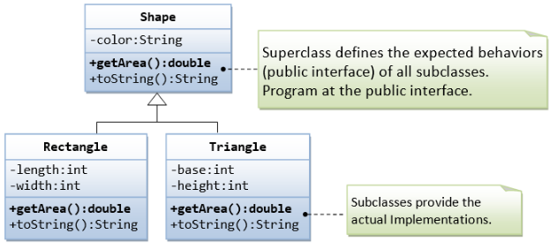
Polymorphism …
A subclass instance can be assigned (substituted) to a superclass' reference.
Once substituted, we can invoke methods defined in the superclass; we cannot invoke methods defined in the subclass.
However, if the subclass overrides inherited methods from the superclass, the subclass (overridden) versions will be invoked.

Slide 32
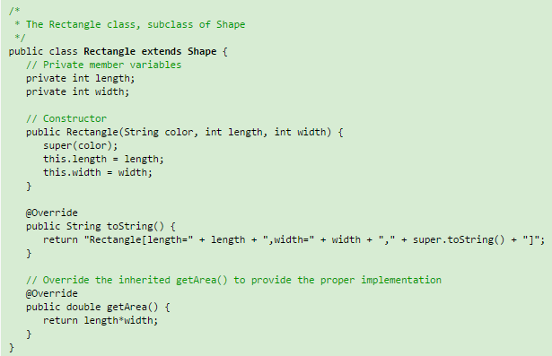
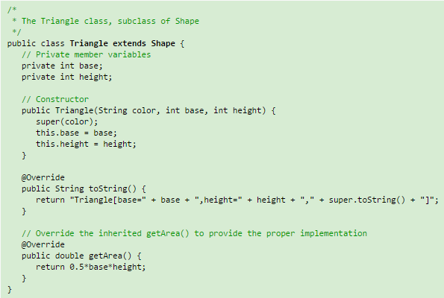
Polymorphism - example

Slide 33
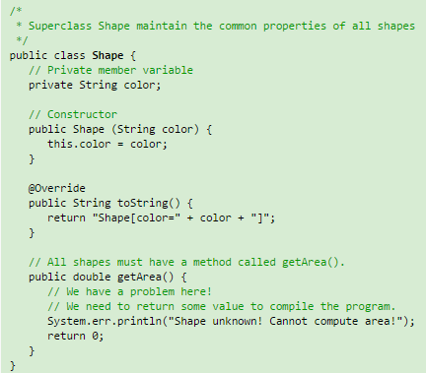
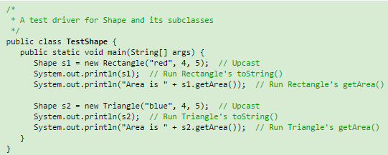
Polymorphism – example …
S

Slide 34
Upcasting & Downcasting
Upcasting a Subclass Instance to a Superclass Reference
  Shape s1 = new Rectangle(); // Compiler checks to ensure that R-value is a subclass of L-value.
  Shape s2 = new String(); // Compilation error: incompatible types
Downcasting a Substituted Reference to Its Original Class
  Shape s1 = new Triangle(); // upcast is safe
  Shape r1 = (Rectangle) s1; // downcast needs the casting operatorDowncasting requires explicit type casting operator in the form of prefix operator (new-type).

Slide 35
Part III

Slide 36
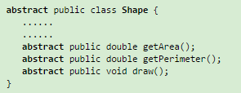
Abstract Classes & Methods
The abstract Method and abstract class
  An abstract method is a method with only signature (i.e., the method name, the list of arguments and the return type) without implementation (i.e., the method’s body).
  You use the keyword abstract to declare an abstract method.
  For example, in the Shape class, we can declare abstract methods getArea(), draw(), etc, as follows:
A class containing one or more abstract methods is called an abstract class.
An abstract class must be declared with a class-modifier abstract.
An abstract class CANNOT be instantiated, as its definition is not complete.

Slide 37
Abstract Classes & Methods
Notes:
  An abstract method cannot be declared final, as final method cannot be overridden.
  An abstract method, on the other hand, must be overridden in a descendant before it can be used.
  An abstract method cannot be private (which generates a compilation error). This is because private method are not visible to the subclass and thus cannot be overridden.
In summary, an abstract class provides a template for further development.

Slide 38
The Java's interface
A Java interface is a 100% abstract superclass which define a set of methods its subclasses must support.
An interface contains only public abstract methods (methods with signature and no implementation) and possibly constants (public static final variables).
You have to use the keyword "interface" to define an interface (instead of keyword "class" for normal classes). The keyword public and abstract are not needed for its abstract methods as they are mandatory.
Similar to an abstract superclass, an interface cannot be instantiated. You have to create a "subclass" that implements an interface, and provide the actual implementation of all the abstract methods.

Slide 39
The Java's interface …
Unlike a normal class, where you use the keyword "extends" to derive a subclass. For interface, we use the keyword "implements" to derive a subclass.
An interface is a contract for what the classes can do. It, however, does not specify how the classes should do it.
An interface provides a form, a protocol, a standard, a contract, a specification, a set of rules, an interface, for all objects that implement it. It is a specification and rules that any object implementing it agrees to follow.
In Java, abstract class and interface are used to separate the public interface of a class from its implementation so as to allow the programmer to program at the interface instead of the various implementation.

Slide 40

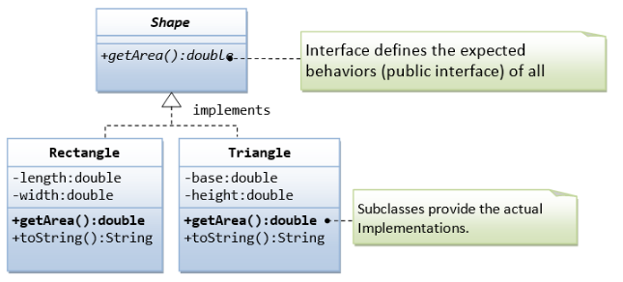
interface - example

Slide 41
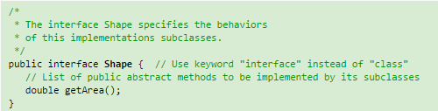
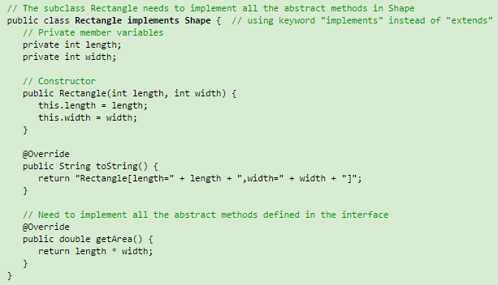
interface …

Slide 42
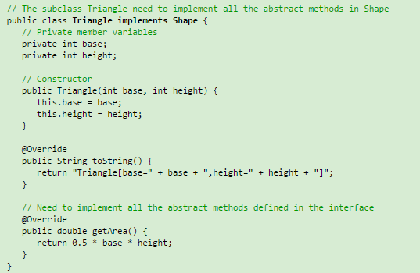
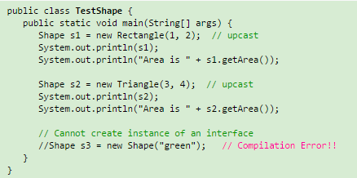
interface …

Slide 43
"Is-a" vs. "has-a" relationships
"Is-a" relationship: A subclass object processes all the data and methods from its superclass (and it could have more). We can say that a subclass object is-a superclass object (is more than a superclass object). Refer to "polymorphism".
"has-a" relationship: In composition, a class contains references to other classes, which is known as "has-a" relationship.
You can use "is-a" and 'has-a" to test whether to design the classes using inheritance or composition.

Slide 44
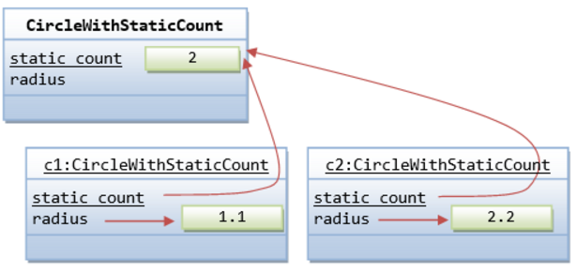
The "static" Variables and Methods
You can apply modifier "static" to variables and methods.
A static variable/method belongs to the class, and is shared by all instances. Called class variable/method
a non-static variable/method (absence of keyword static) belongs to a specific instance of a class, also called an instance variable/method.

Slide 45
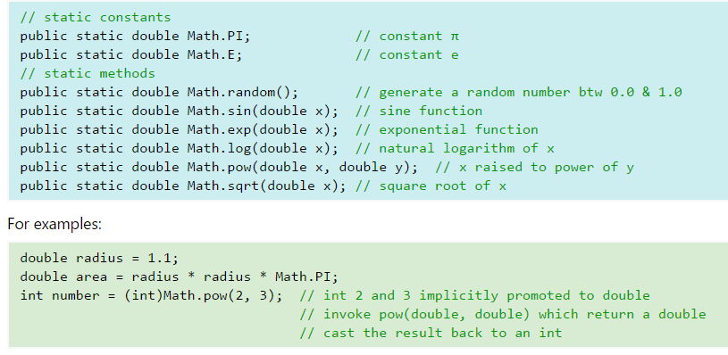
static Method
Example: java.lang.Math - Mathematical Functions & Constants
No Need for instantiation

Slide 46
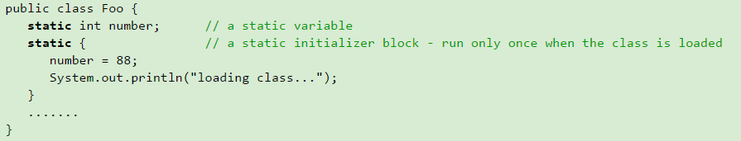
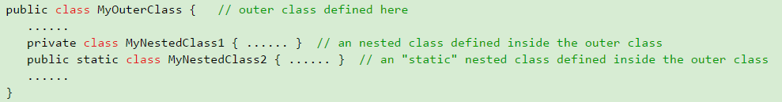
More …
Static Initializer
Nested (Inner) Classes

Slide 47
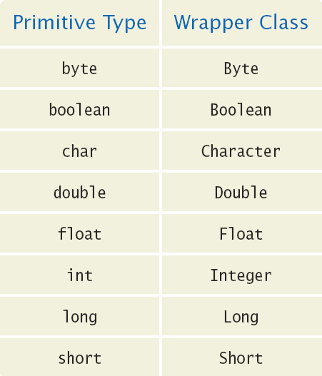
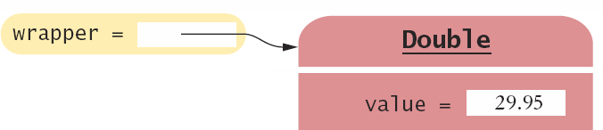
Wrappers and Auto-boxing
Java provides wrapper classes for primitive types
  Conversions are automatic using auto-boxing
    Primitive to wrapper Class
    Wrapper Class to primitive
double x = 29.95;
Double wrapper;
wrapper = x; // boxing
double x;
Double wrapper = 29.95;
x = wrapper; // unboxing

Slide 48
Wrappers and Auto-boxing
You cannot use primitive types in an ArrayList, but you can use their wrapper classes
Declare the ArrayList with wrapper classes for primitive types
  Use ArrayList<Double>
    Add primitive double variables
    Or double values
double x = 19.95;
ArrayList<Double> values = new ArrayList<Double>();
values.add(29.95); // boxing
values.add(x); // boxing
double x = values.get(0); // unboxing

Slide 49
Generic
Generics is a compiler mechanism whereby you can create (and use) types of things (such as classes or interfaces, and methods) in a generic fashion by harvesting the common code and parameterizing(or templatizing) the rest.
This approach to programming is called generic programming.
The most commonly used type parameter names are:
  E - Element (used extensively by the Java Collections Framework)
  K - Key
  N - Number
  T - Type
  V - Value

Slide 50
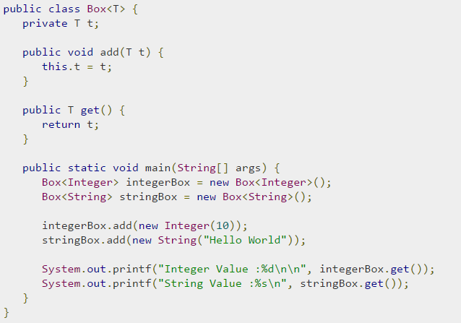
Generic Classes
A generic class declaration looks like a non-generic class declaration,
except that the class name is followed by a type parameter section.
As with generic methods, the type parameter section of a generic class can have one or more type parameters separated by commas.
Methods can be generic
Code Example: Generic Linked List

Slide 51
Part II

Slide 52
Partially-Filled Arrays
An array cannot change size at run time
  The programmer may need to guess at the maximum number of elements required
  It is a good idea to use a constant for the size chosen
  Use a variable to track how many elements are filled
final int LENGTH = 100;
double[] values = new double[LENGTH];
int currentSize = 0;
Scanner in = new Scanner(System.in);
while (in.hasNextDouble())
{
if (currentSize < values.length)
{
values[currentSize] = in.nextDouble();
currentSize++;
}
}
Maintain the number of elements filled using a variable (currentSize in this example)

Slide 53
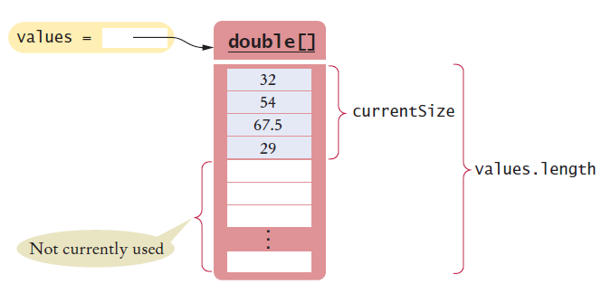
Walking a Partially Filled Array
Use currentSize, not values.length for the last element
for (int i = 0; i < currentSize; i++)
{
System.out.println(values[i]);
}
A for loop is a natural choice to walk through an array

Slide 54
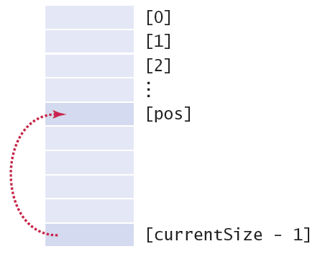
Arrays - Common Algorithms
Removing an element (at a given position)
  Requires tracking the ‘current size’ (# of valid elements)
  But don’t leave a ‘hole’ in the array!
  Solution depends on if you have to maintain ‘order’
    If not, find the last valid element, copy over position, update size
values[pos] = values[currentSize – 1];
currentSize--;

Slide 55
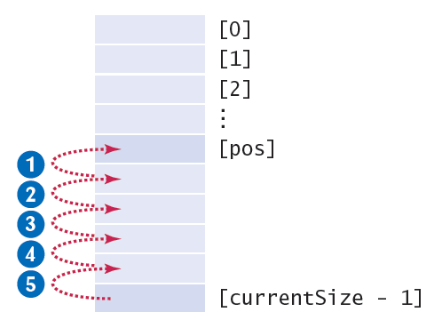
Common Algorithms …
Removing an element and maintaining order
  Requires tracking the ‘current size’ (# of valid elements)
  But don’t leave a ‘hole’ in the array!
  Solution depends on if you have to maintain ‘order’
    If so, move all of the valid elements after ‘pos’ up one spot, update size
for (int i = pos; i < currentSize - 1; i++)
{
values[i] = values[i + 1];
}
currentSize--;

Slide 56
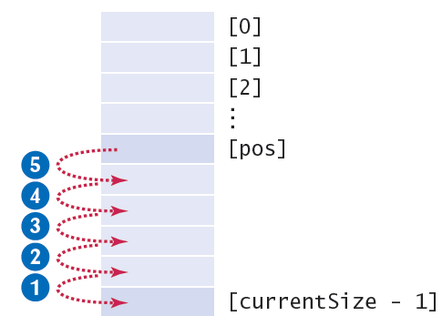
Common Algorithms
Inserting an Element
  Solution depends on if you have to maintain ‘order’
    If not, just add it to the end and update the size
    If so, find the right spot for the new element, move all of the valid elements after ‘pos’ down one spot, insert the new element, and update size
if (currentSize < values.length)
{
currentSize++;
for (int i = currentSize - 1; i > pos; i--)
{
values[i] = values[i - 1]; // move down
}
values[pos] = newElement; // fill hole
}

Slide 57
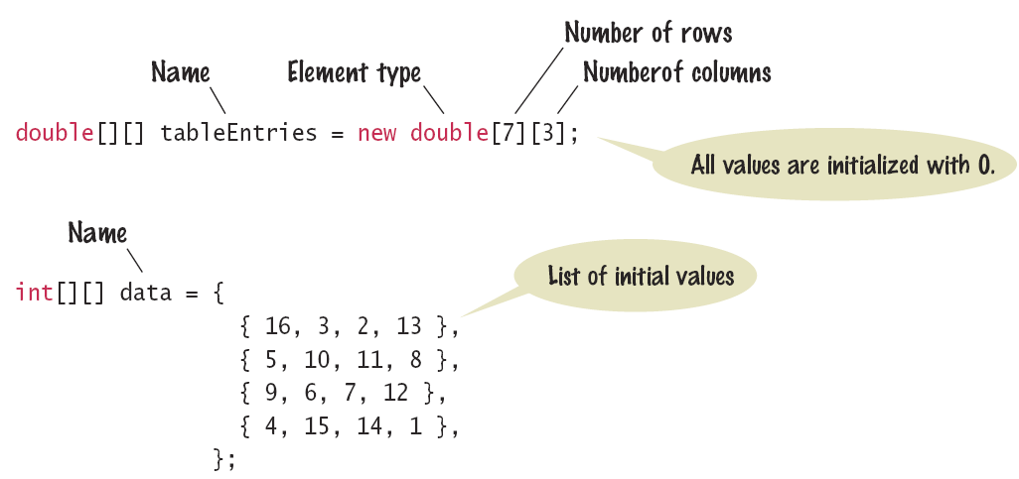
2D Array Declaration
The name of the array continues to be a reference to the contents of the array
  Use new or fully initialize the array

Slide 58
Declaring and Using Array Lists
The ArrayList class is part of the java.util package
  Built-in
  It is a generic class
    Designed to hold many types of objects
  Provide the type of element during declaration
    Inside < > as the ‘type parameter’:
    The type must be a Class
    Cannot be used for primitive types (int, double…)
ArrayList<String> names = new ArrayList<String>();

Slide 59
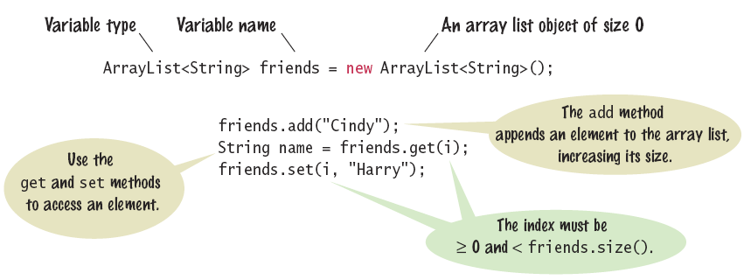
Syntax - Array Lists
ArrayList provides many useful methods:
  add: add an element
  get: return an element
  remove: delete an element
  set: change an element
  size: current length

Slide 60
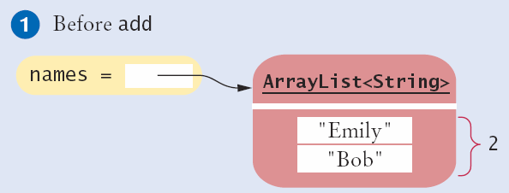
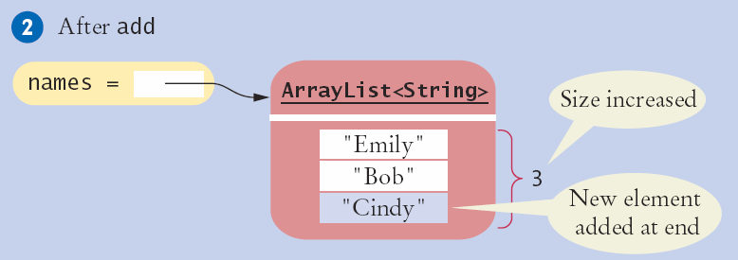
Adding an element with add()
The add method has two versions:
  Pass a new element to add to the end
names.add(“Cindy”);

Slide 61
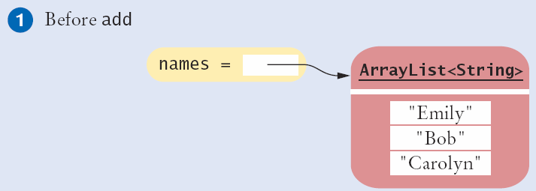
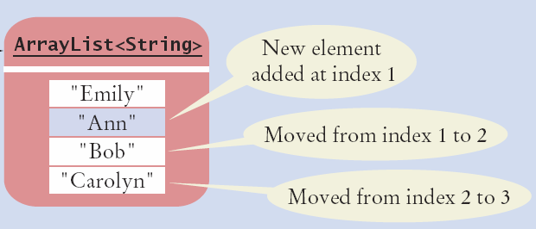
Adding an Element in the Middle
  Pass a location (index) and the new value to add
    Moves all other elements
names.add(1, “Ann”);

Slide 62


Removing an Element
  Pass a location (index) to be removed
    Moves all other elements
names.remove(1);

Slide 63

Working with Array Lists

Slide 64
Choosing Arrays or Array Lists
Use an Array if:
  The size of the array never changes
  You have a long list of primitive values
    For efficiency reasons
  Your instructor wants you to
Use an Array List:
  For just about all other cases
  Especially if you have an unknown number of input values

Slide 65

Array and Array List Operations

Slide 66


Common Error
Length versus Size
  Unfortunately, the Java syntax for determining the number of elements in an array, an ArrayList, and a String is not consistent.
  It is a common error to confuse these. You just have to remember the correct syntax for each data type.

Slide 67
Linked List Example
See LinkedList.java
Test with ListDemo.java

Slide 68
Part IV

Slide 69
Priority Queues
Usage
  Operating system scheduling - Process jobs by priority
  Graph algorithms - Find shortest path
  Event simulation
ADT interface design
  Add/Insert
  Remove (Max or Min)
  isEmpty
Implementation
  Primitive arrays – contiguous memory
  Linked Lists - pointer
  Binary Heap – binary tree

Slide 70
Priority Queues – Elementry
Array representation (ordered):
  See sample code
Linked-list representations (ordered):
  See sample code
Binary Heap:
  See sample code

Slide 71



What is a Heap
a binary tree with two additional constraints:
  Complete binary tree; that is, all levels of the tree, except possibly the last one (deepest) are fully filled, and, if the last level of the tree is not complete, the nodes of that level are filled from left to right.
  The key stored in each node is either greater than or equal to (≥) or less than or equal to (≤) the keys in the node's children.

Slide 72


Binary Tree As Array
Complete Binary Tree as array

Slide 73


Min Heap - Insert

Slide 74


Min Heap - Remove

Slide 75


Priority Queue – big-O
Java Code:
http://www.sanfoundry.com/java-program-implement-binary-heap/

